Slide 1
SAN CARLOS INTEGRATED MANAGEMENT SYSTEM (SCIMS)

Slide 2
Objective
Context Data Flow Diagram
Program Flow Diagram
Data Structure
User Roles
User Interface

Slide 3
System Module:
Vamos Cares
User Credential
Resbakuna

Slide 4
CONTEXT DATA FLOW
& PROGRAM FLOW DIAGRAM

Slide 5
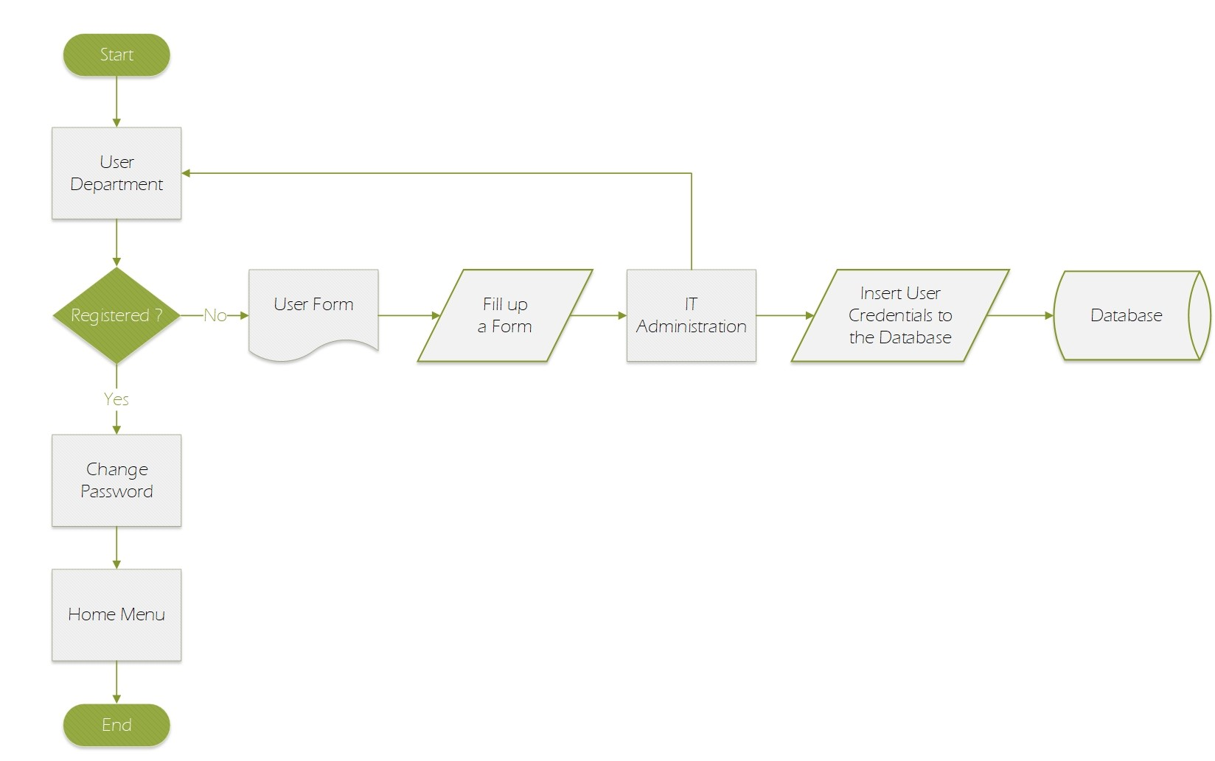
Context Data Flow Diagram
of User Credentials

Slide 6
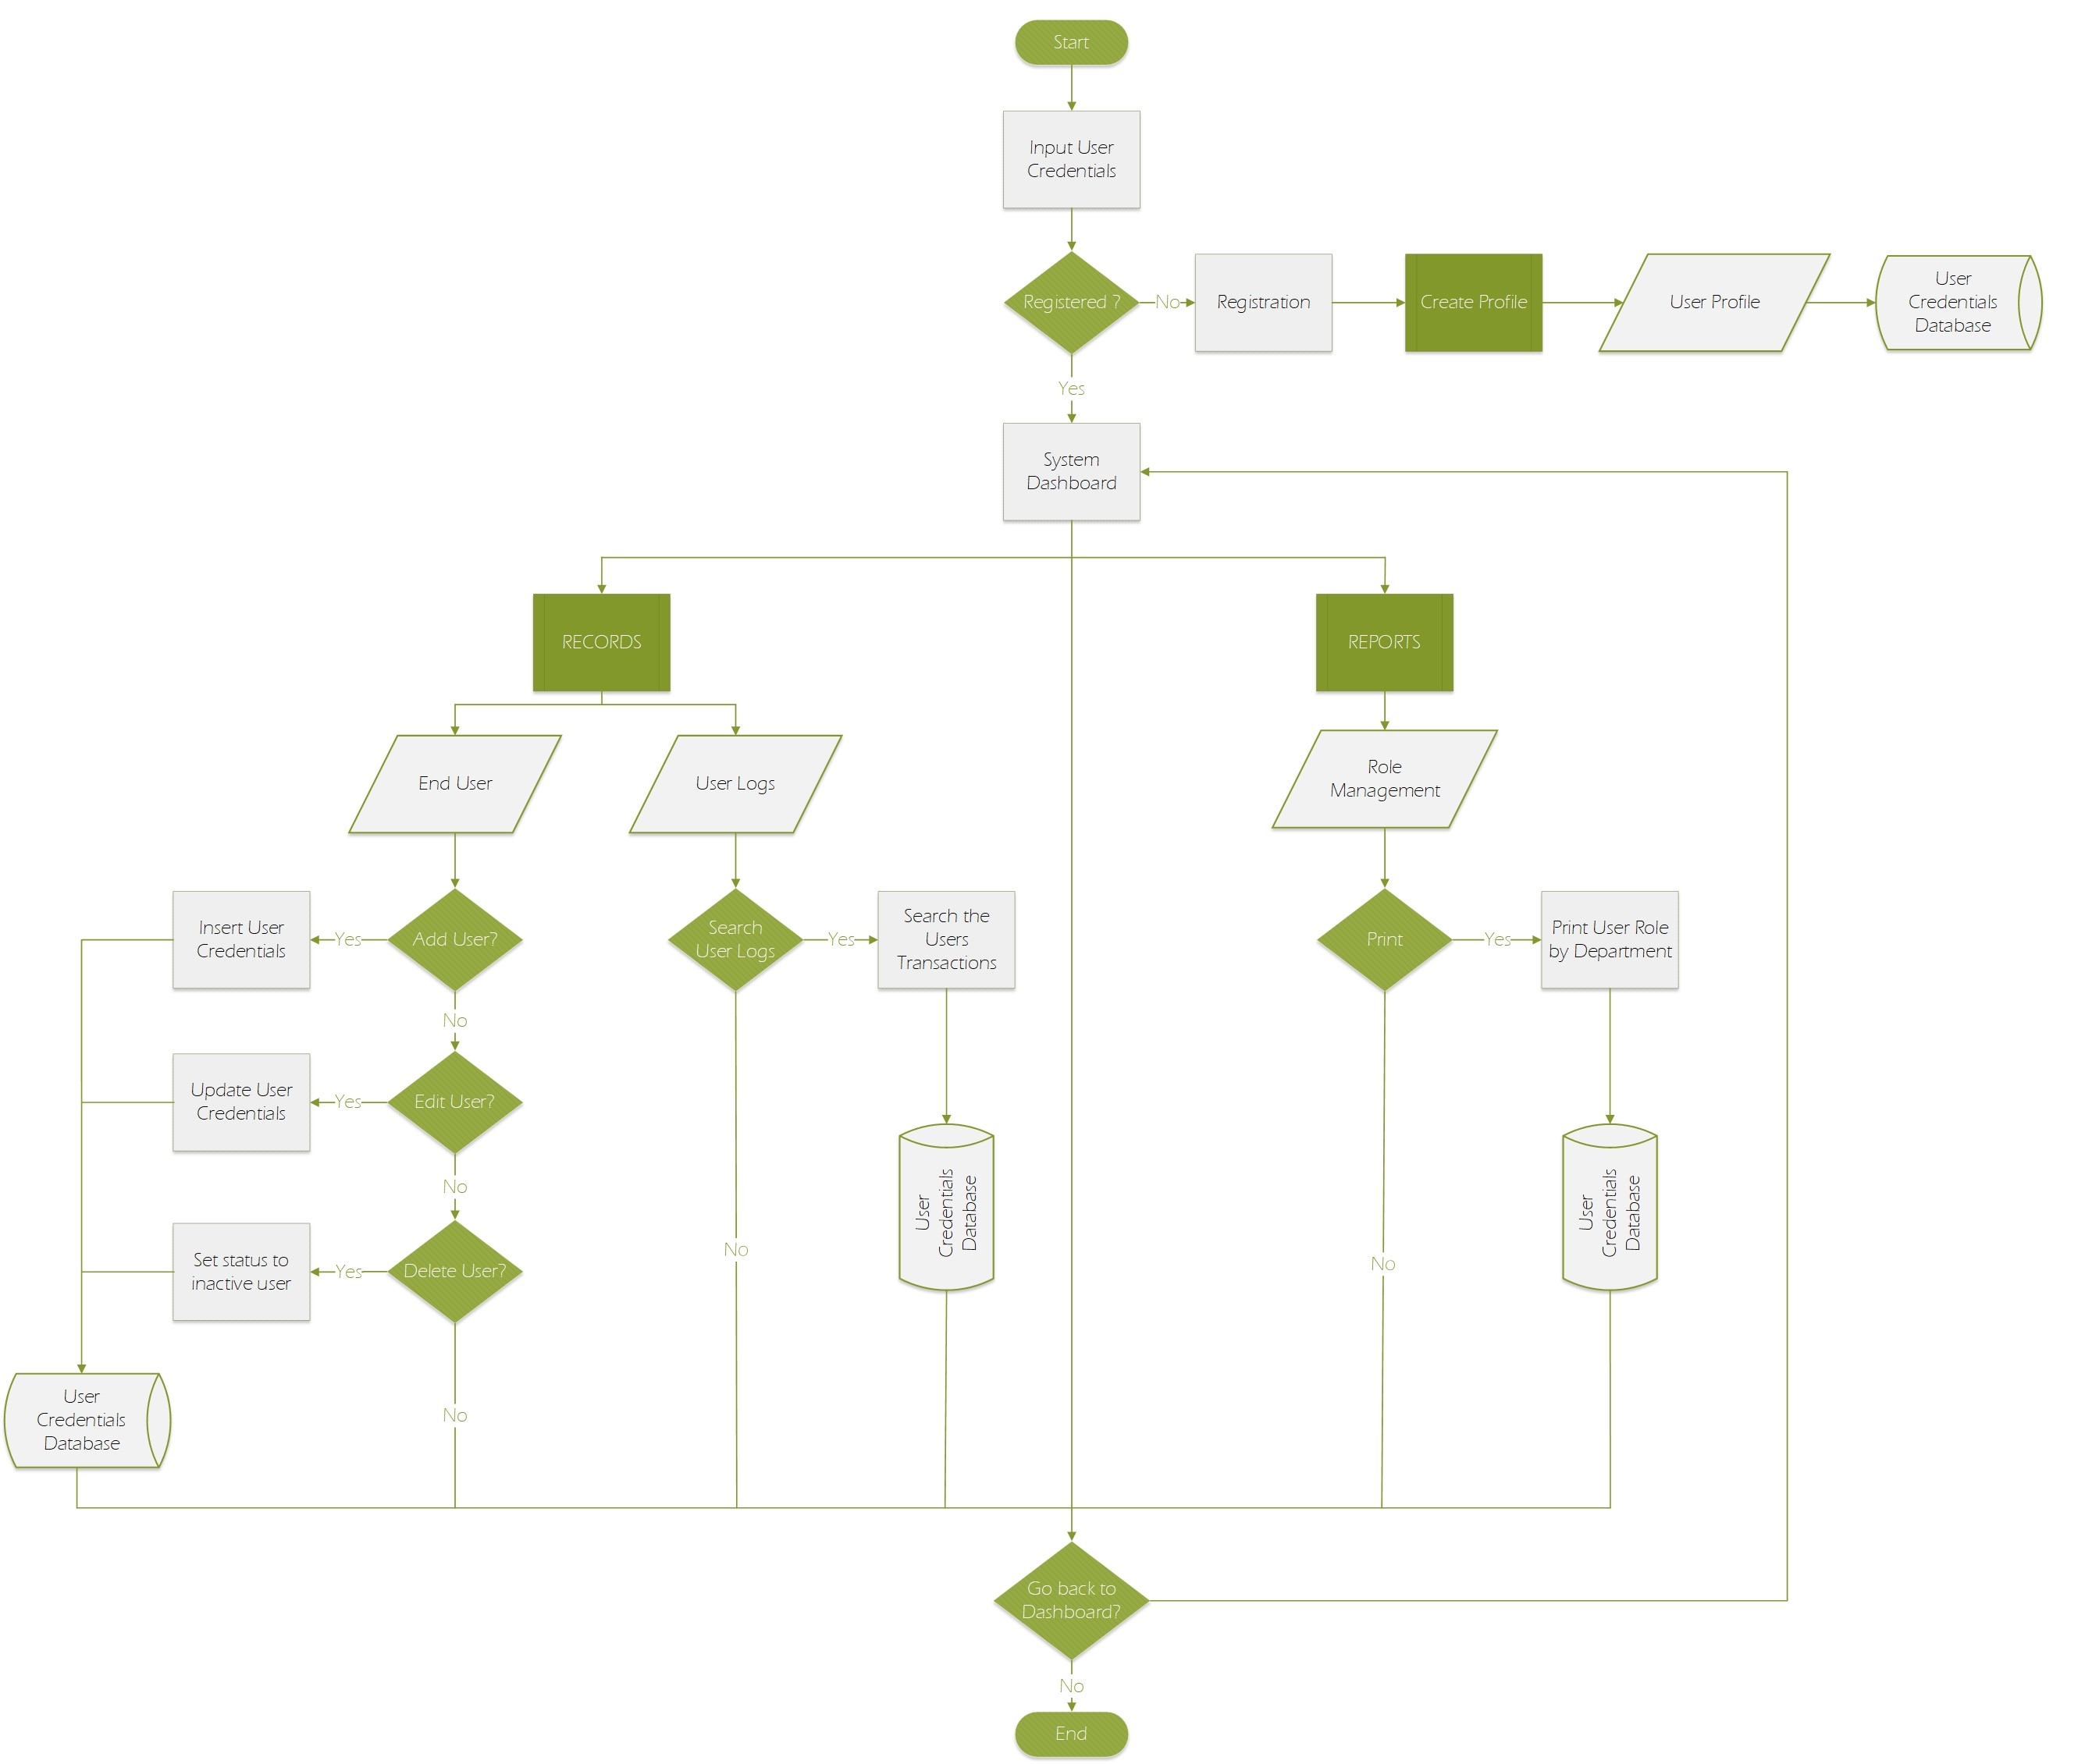
Program Flow Diagram
of User Credential

Slide 7
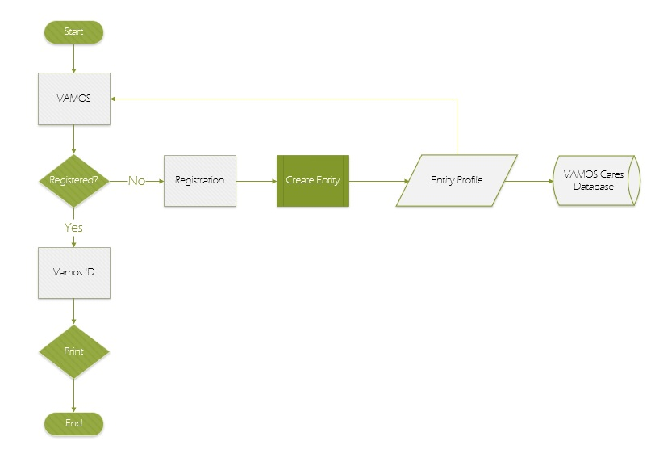
Context Data Flow Diagram of Vamos Cares

Slide 8
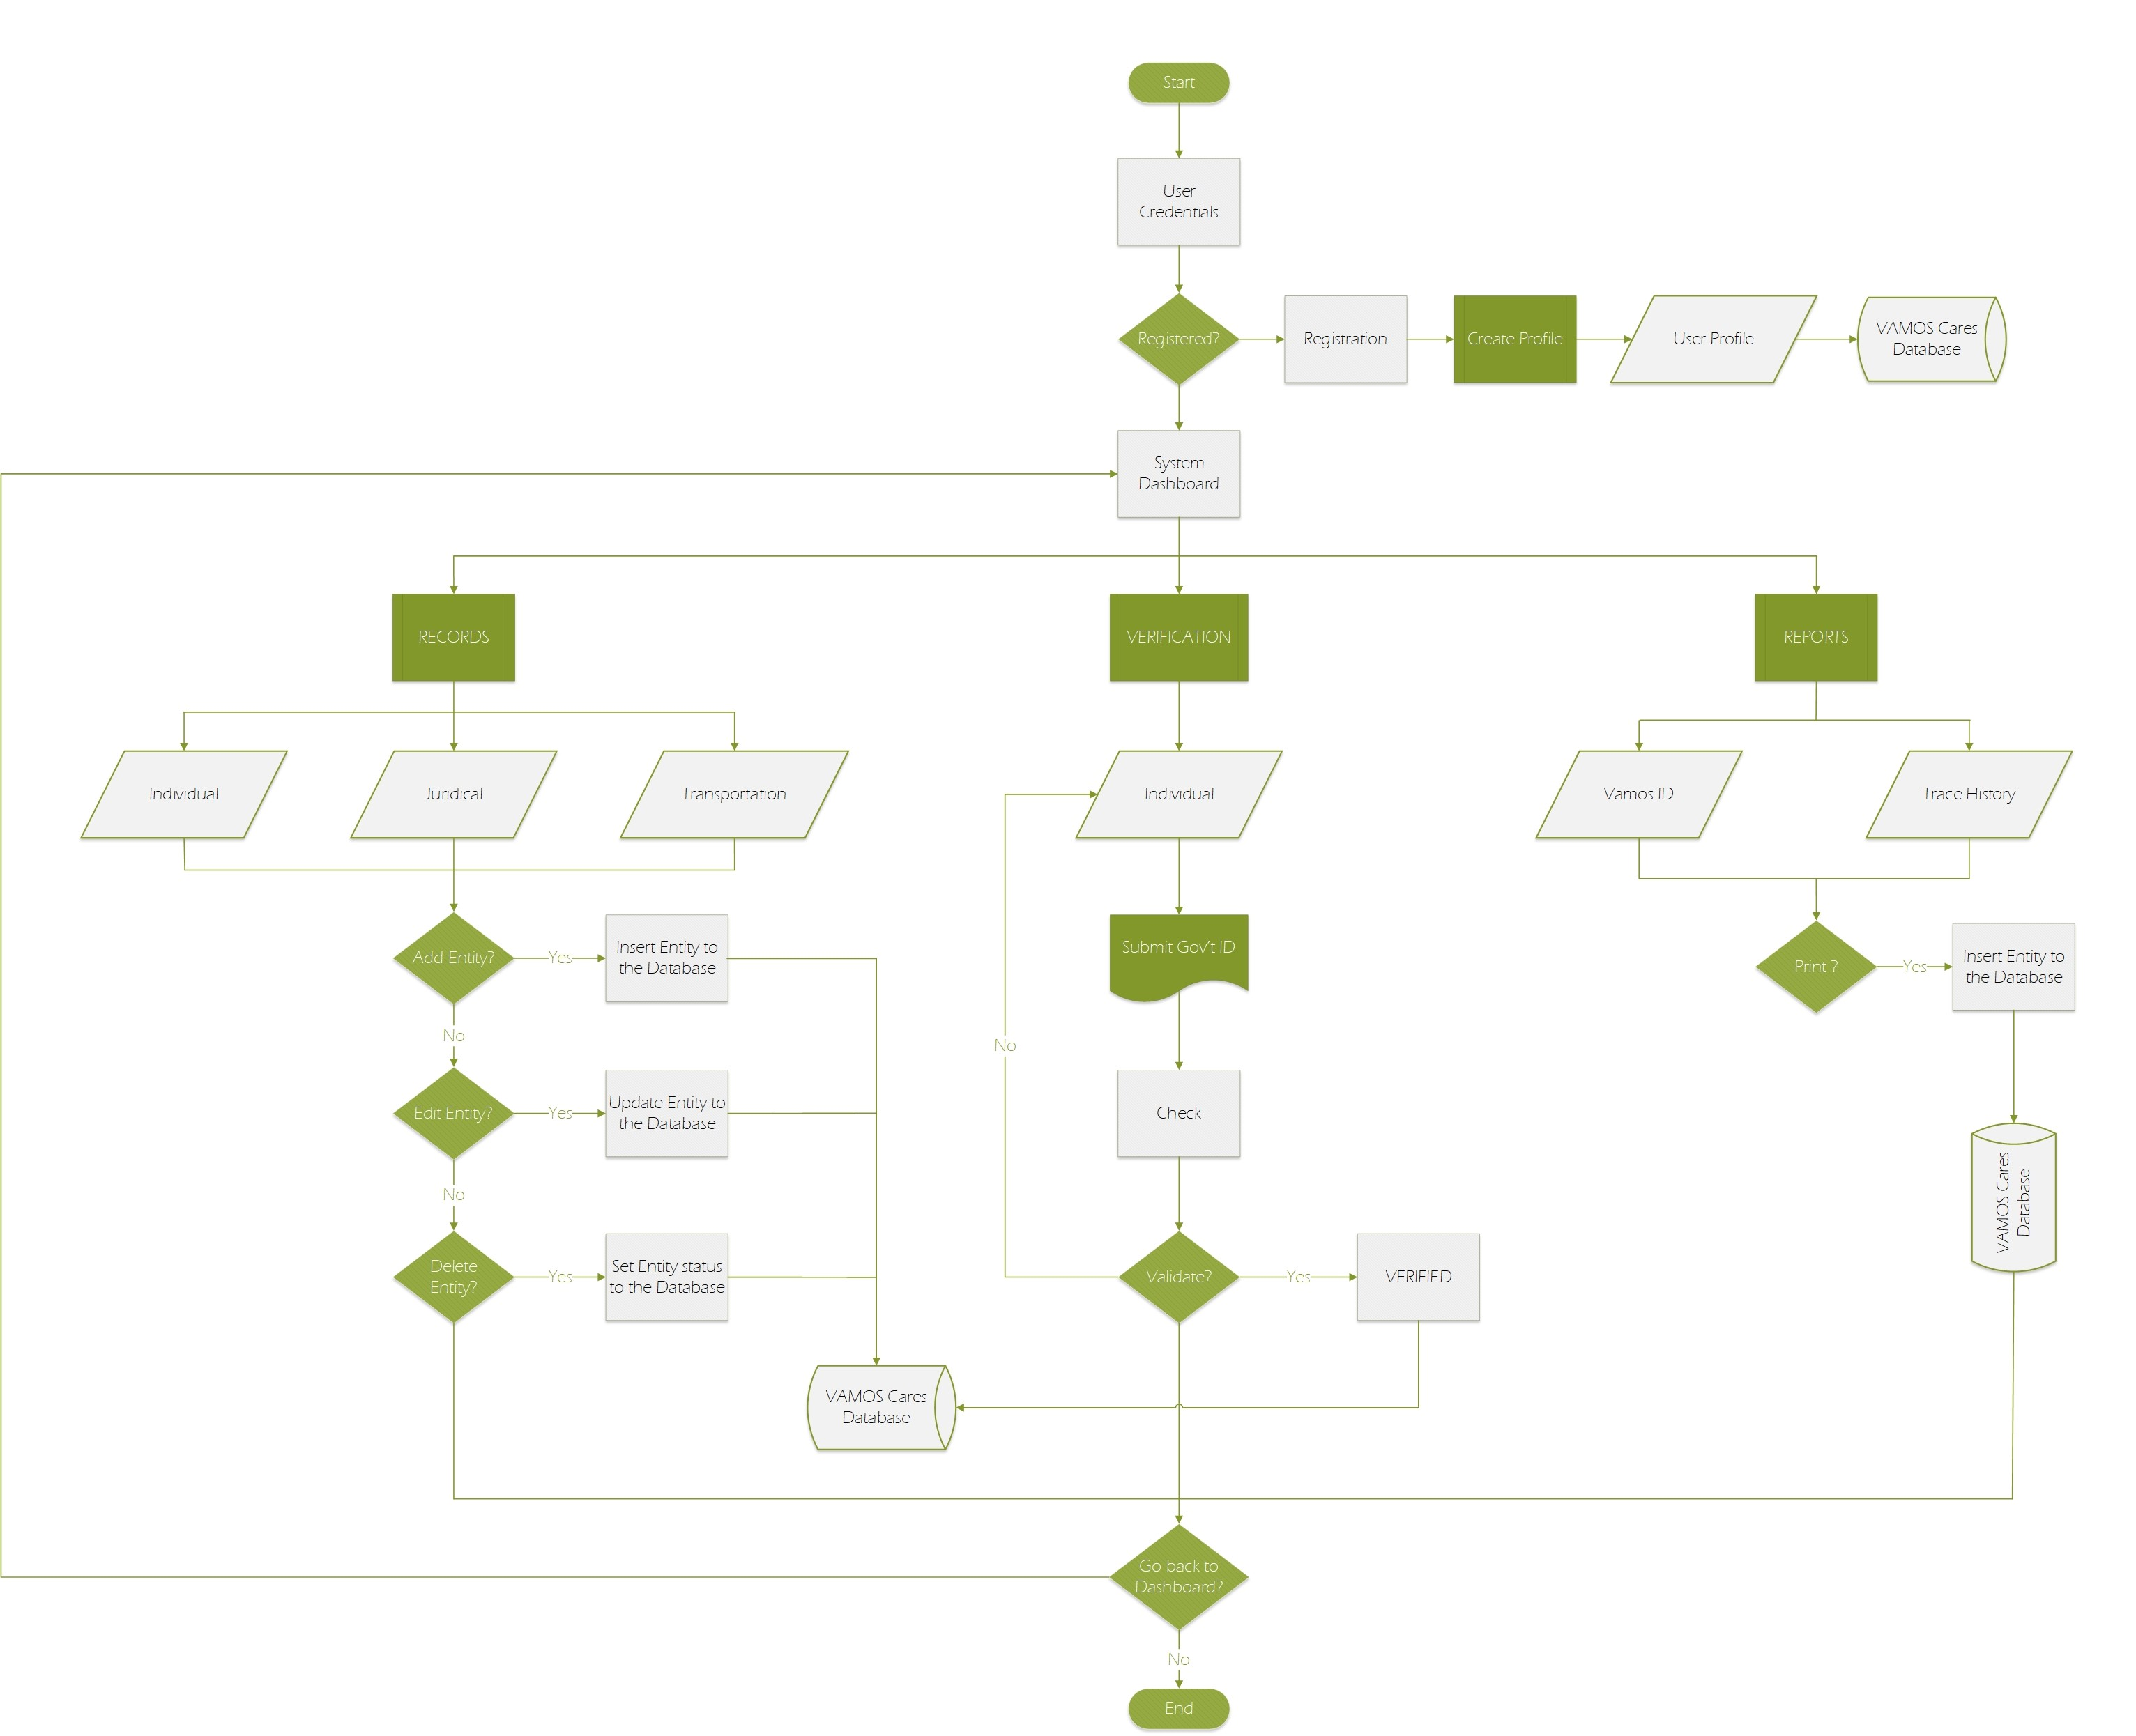
Program Flow Diagram
of Vamos Cares

Slide 9
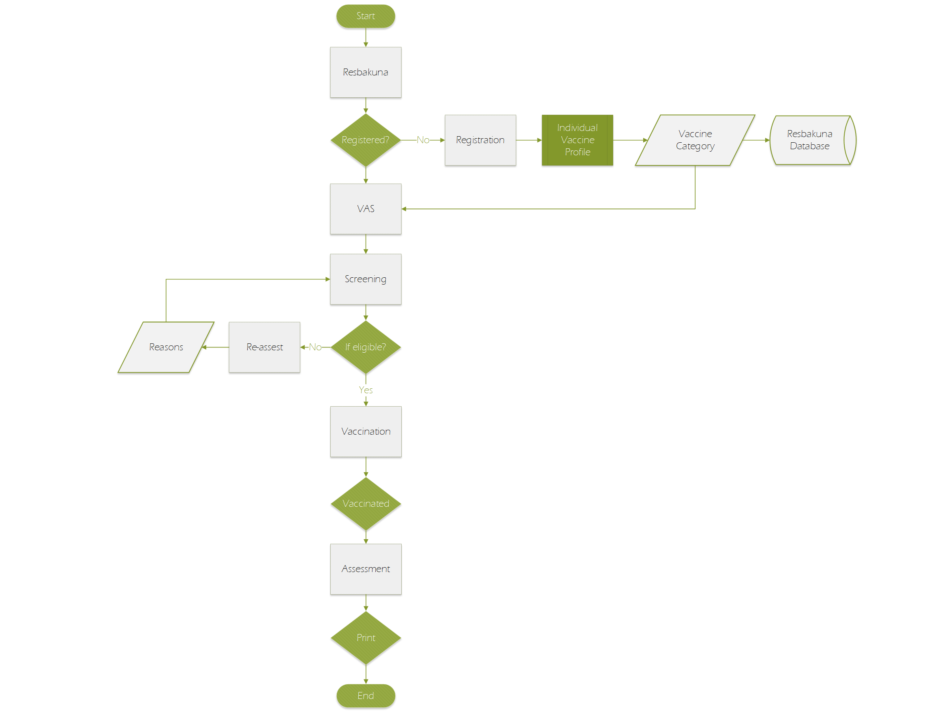
Data Flow Diagram
of Resbakuna

Slide 10
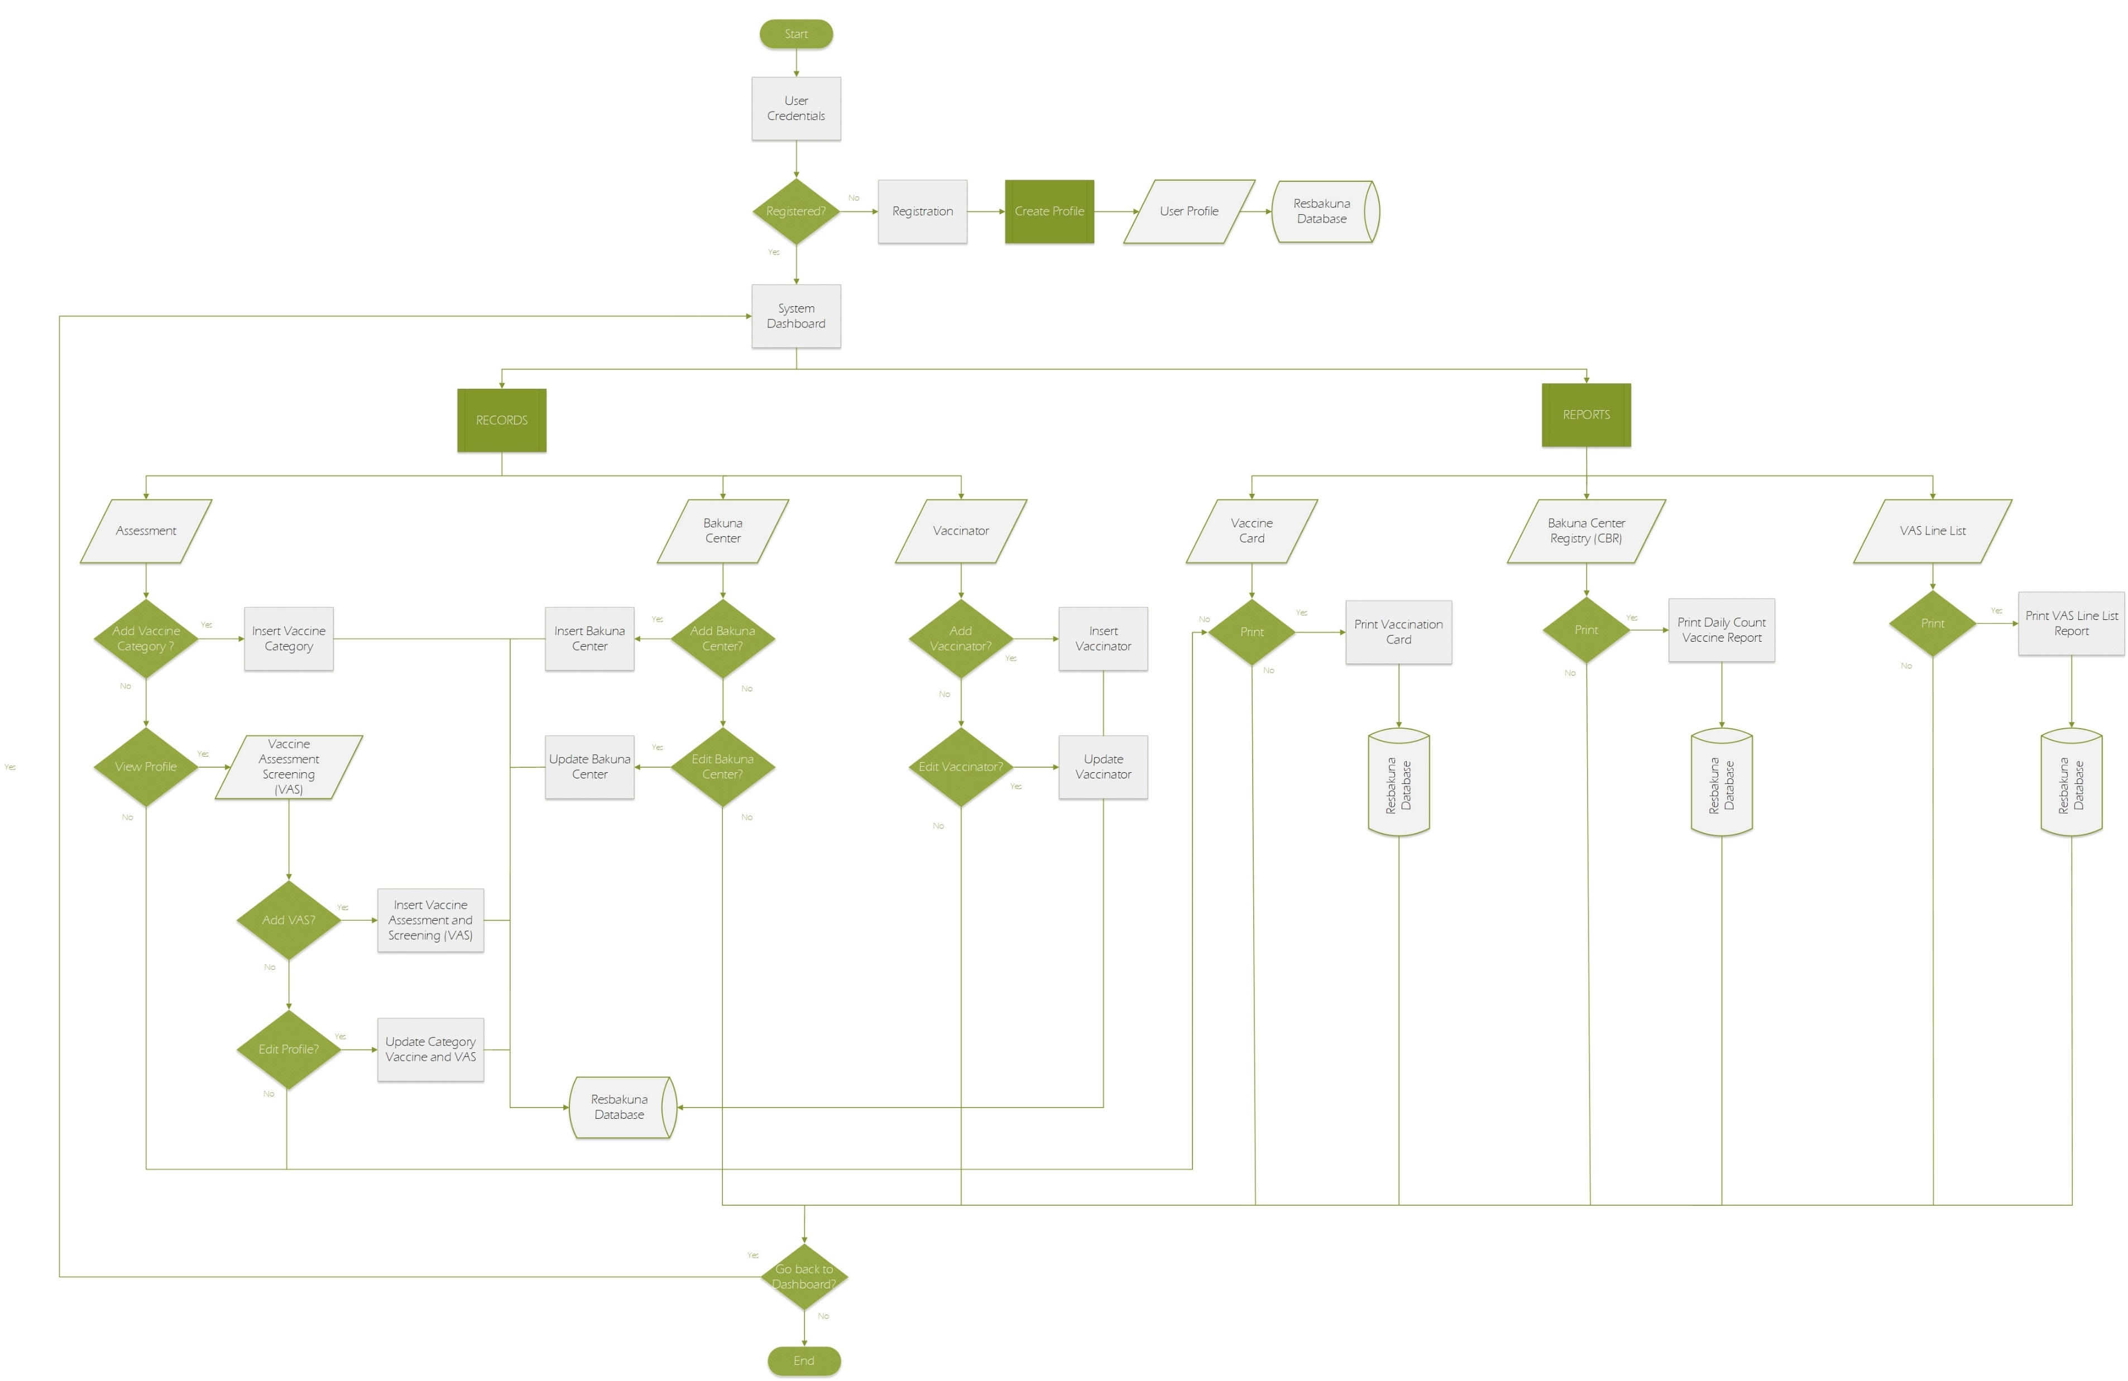
Program Flow Diagram
of Resbakuna

Slide 11
DATA STRUCTURE

Slide 12
Data Structure
Basic Information
User Credential
Vamos Cares
Resbakuna

Slide 13
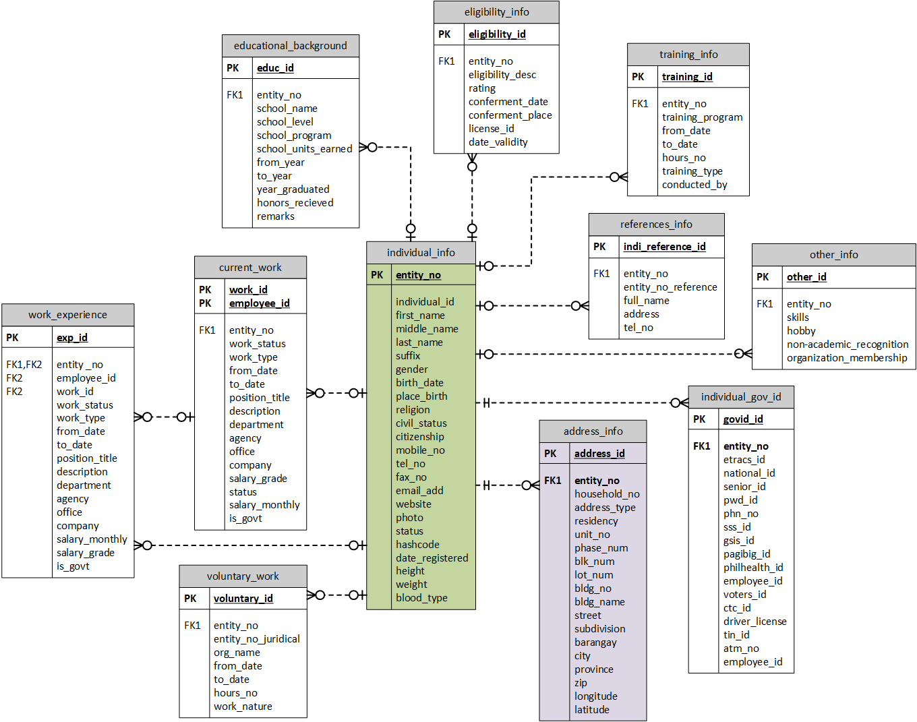
Basic Information
Data Structure

Slide 14
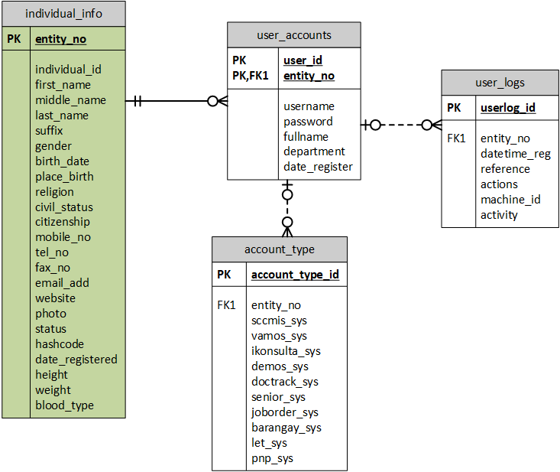
User Credentials
Data Structure

Slide 15
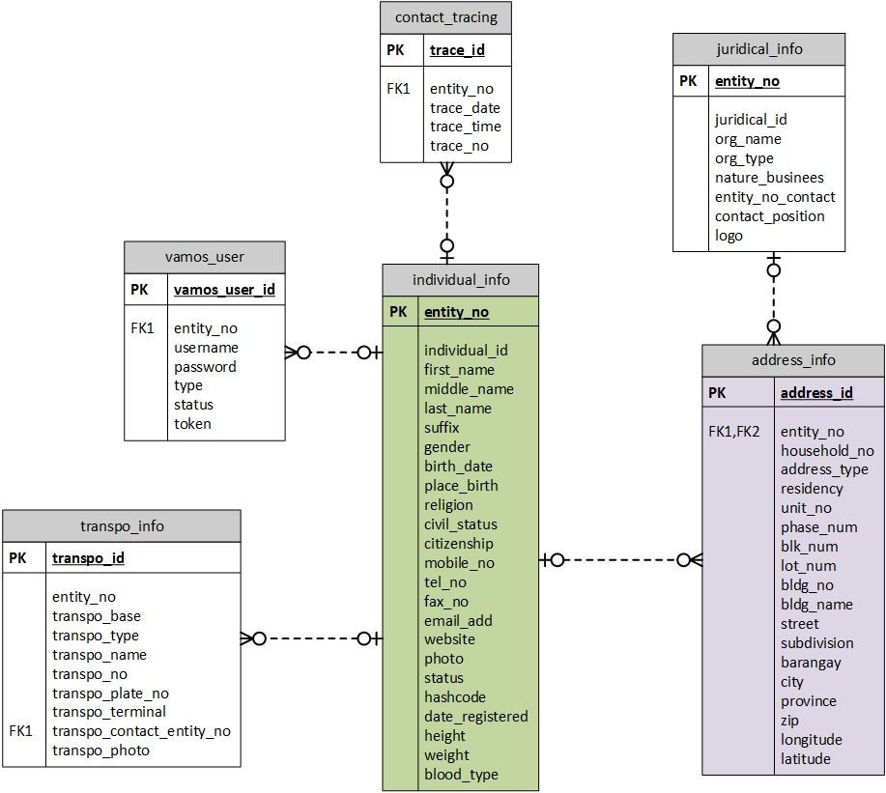
Vamos Cares
Data Structure

Slide 16
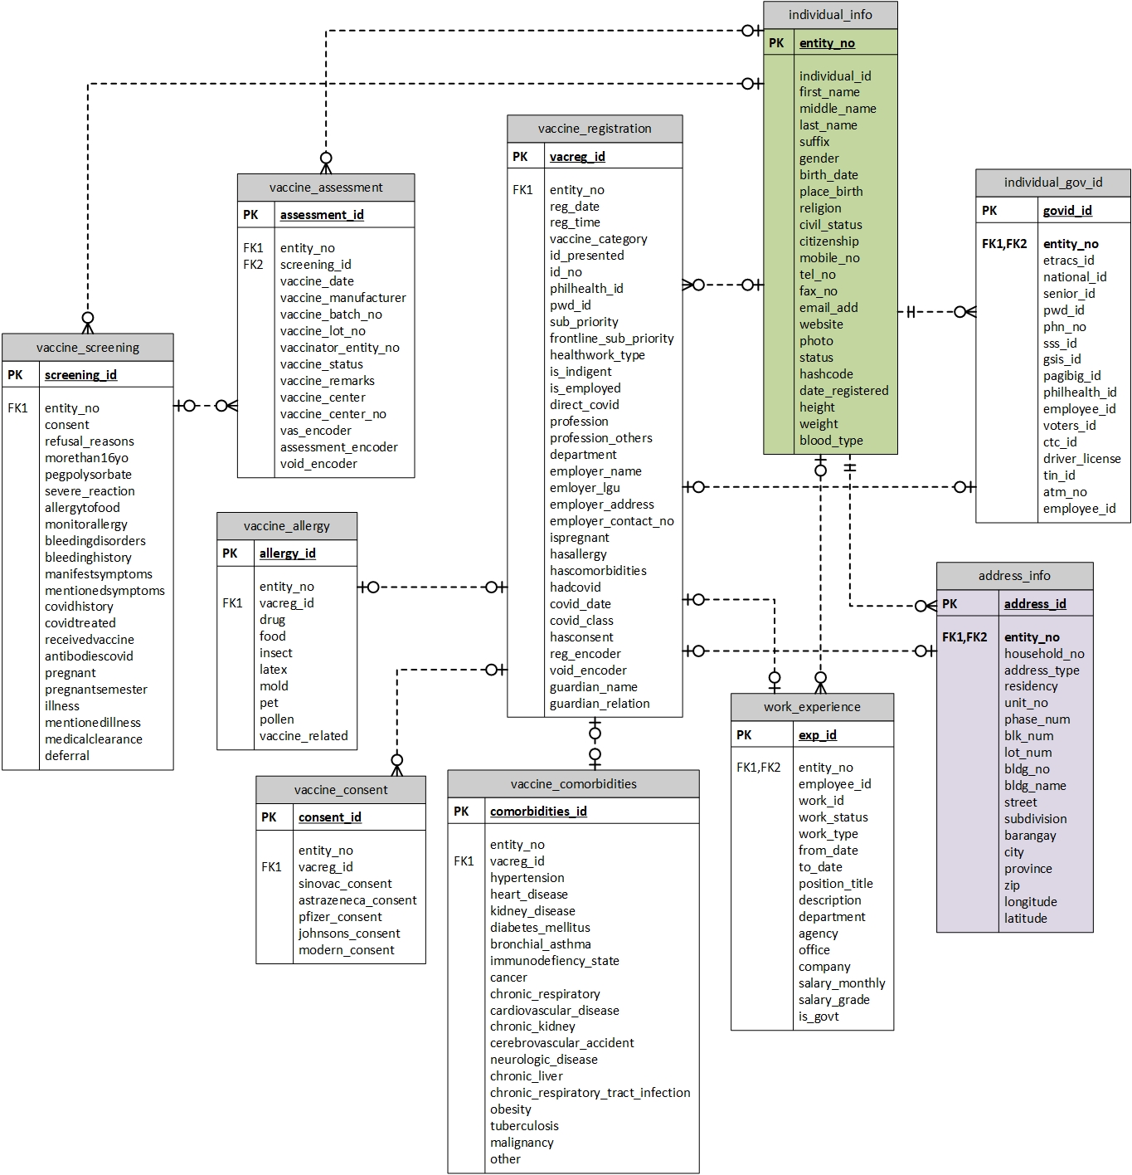
Resbakuna
Data Structure

Slide 17
USER ROLE

Slide 18
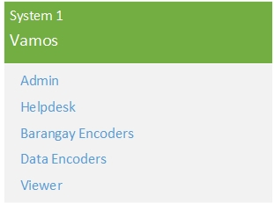
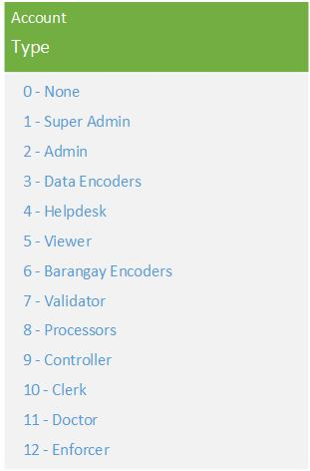
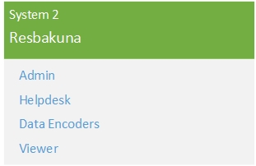

Slide 19
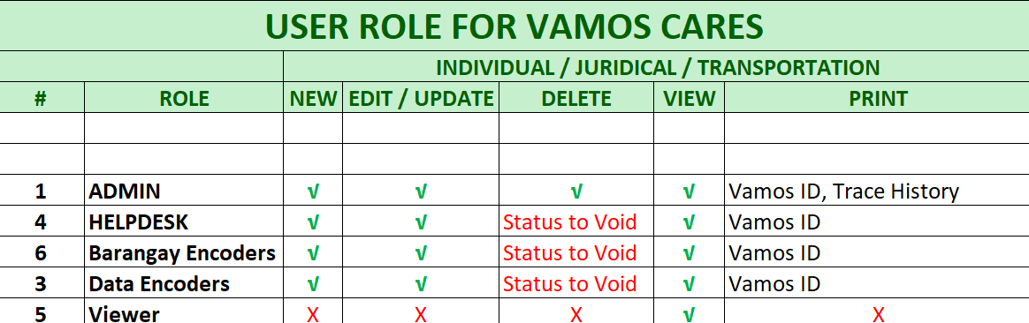

Slide 20
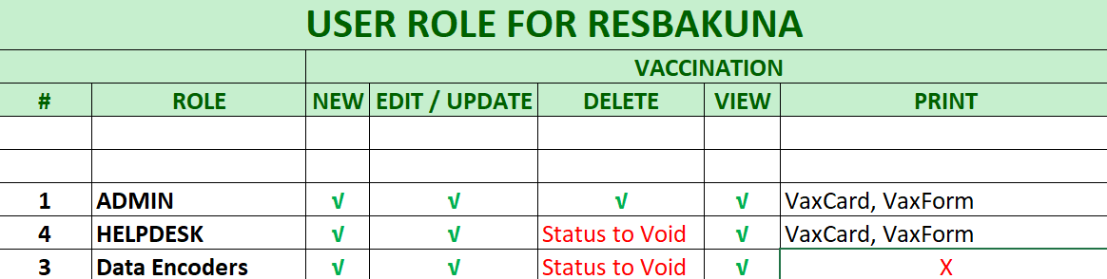

Slide 21
USER INTERFACE

Slide 22
User Interface
Log In
Change Password
Lock Screen
Home (System Modules)
Default Sidebar

Slide 23
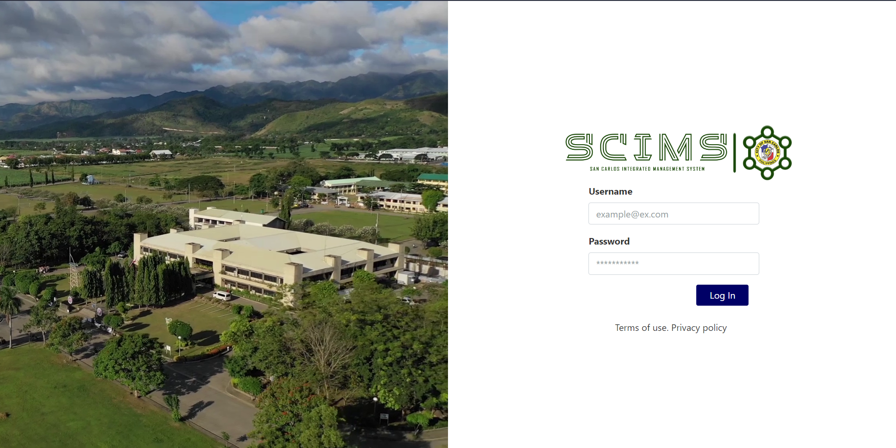
UI : Log In Screen

Slide 24
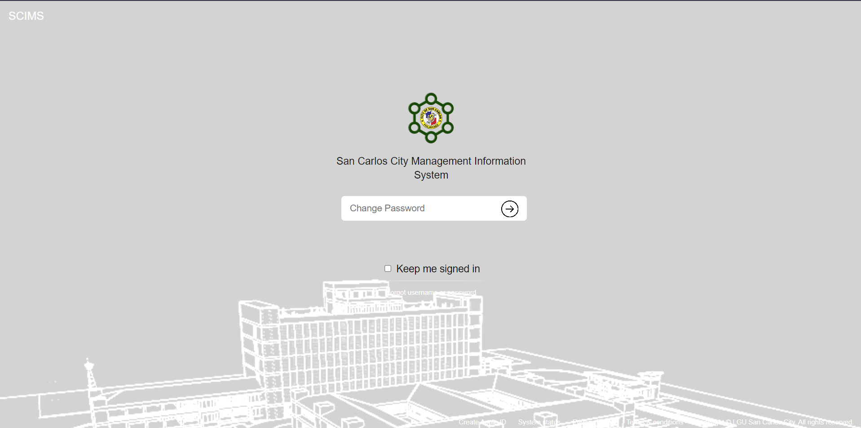
UI : Change Password

Slide 25
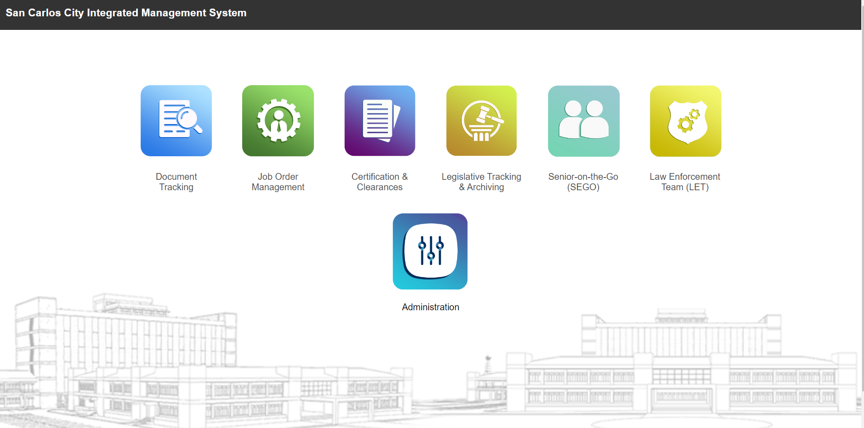
UI : Home

Slide 26
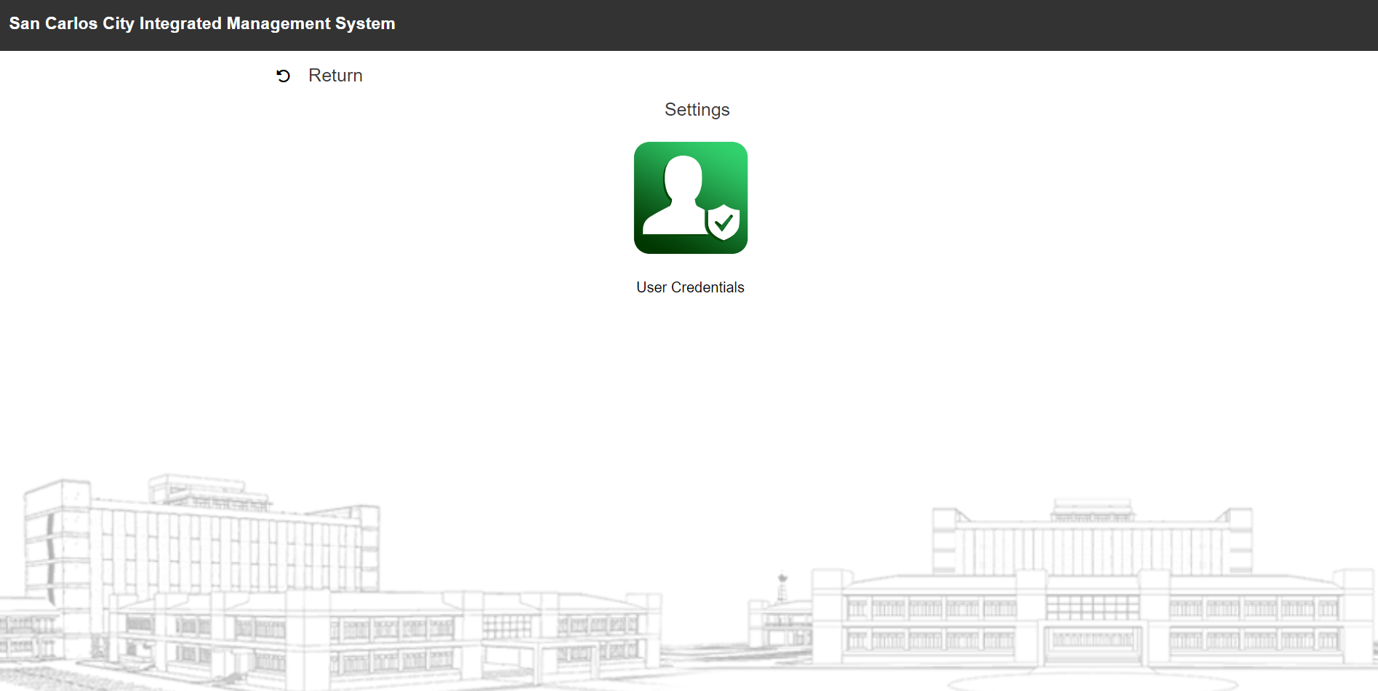
UI : Administration

Slide 27
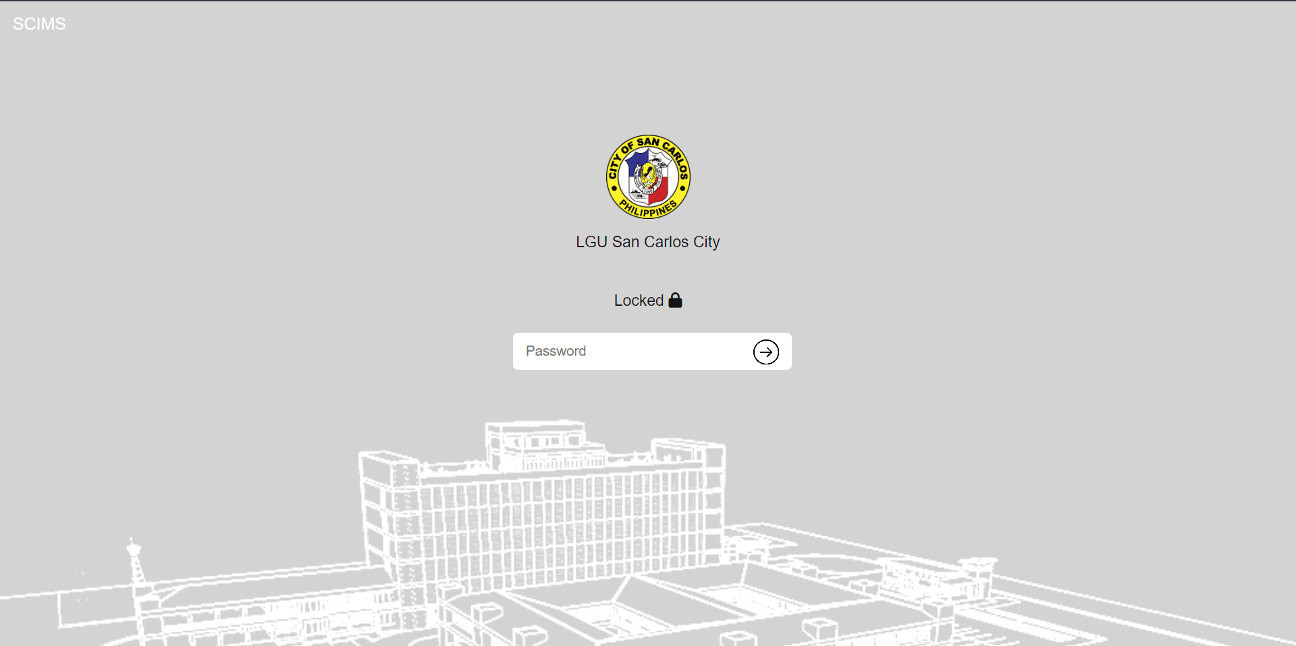
UI : Lock Screen

Slide 28
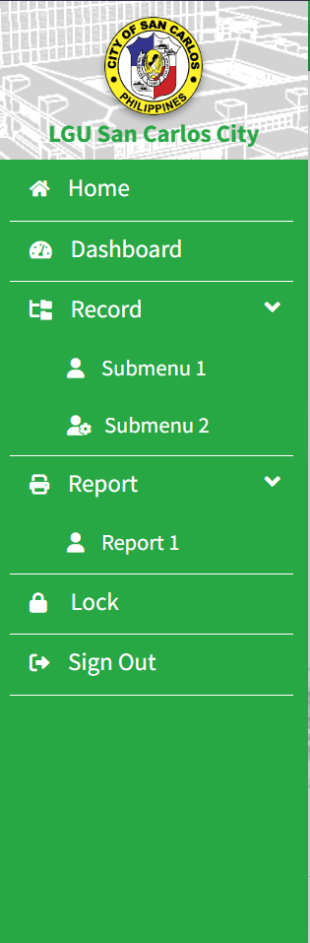
UI: Default Sidebar
For Navbar:
- Name of the System
- Search Bar
- Notifications
- Message/Inbox
- Contact Us
Sidebar
- About Us

Slide 30
QUESTIONS?

